Slide 1
Debugging of Actor Programs using Rebeca Model Checking Tool
Marjan Sirjani
Professor in Software Engineering
Cyber-Physical Systems Analysis group
Malardalen University, Sweden
Reykjavik University, Iceland
October 27 – 31 , 2019, Dagstuhl Seminar 19442
Programming Languages for Distributed Systems and Distributed Data Management

Slide 2
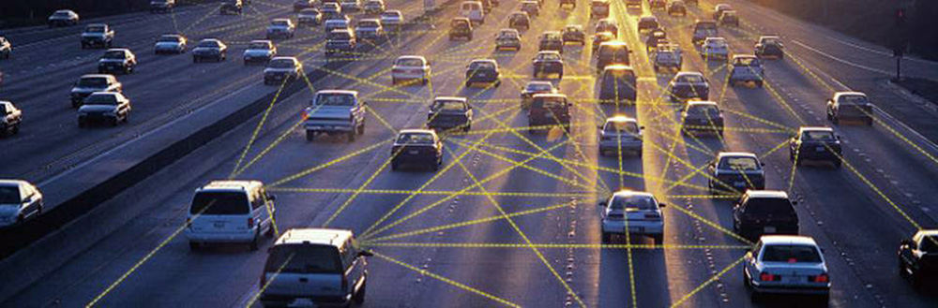
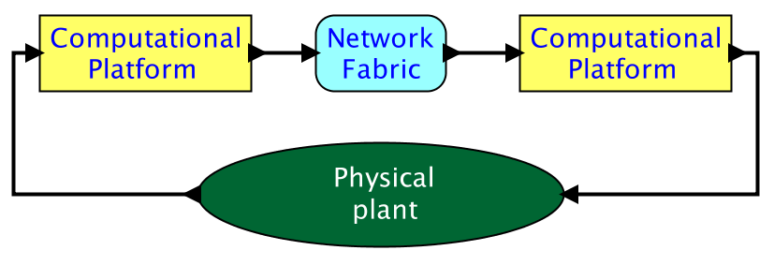
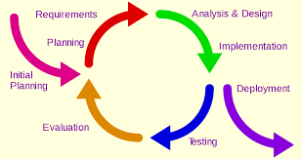
Programming Languages for Distributed Systems
Reactive systems: distributed, concurrent, event-based
Not easy to test concurrent and timed systems
Formal Verification for Safety Critical systems
Formal Verification can be heavy and unfriendly!
We need more friendly and agile approaches for verification of distributed systems.

Slide 3
Different approaches
Abstract
Modeling languages
FDR
CCS
CSP
Mathematical
Petri net
UPPAAL
RML
Timed Automata
NuSMV
Verification Techniques:
Deduction
Model checking
SMV
Spin
needs high expertise
Promela
causes state explosion
Java PathFinder
Too heavy
Informal
Programming languages
Bandera
Java
C
SLAM

Slide 4
Our choice: Actors
A reference model for concurrent computation
Consisting of concurrent, distributed active objects
Proposed by Hewitt as an agent-based language (MIT, 1971)
Developed by Agha as a concurrent object-based language (Illinois, since 1984)
Formalized by Talcott (with Agha, Mason and Smith): Towards a Theory of Actor Computation (CONCUR 1992)

Slide 5
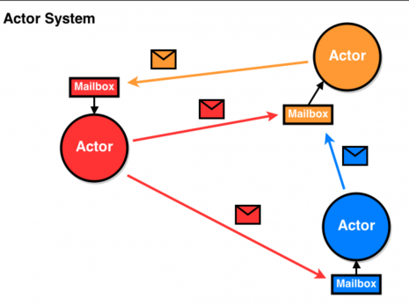
Rebeca: The Modeling Language Asynchronous and Event-driven
Rebeca: Reactive object language (Sirjani, Movaghar, 2001)
Based on Hewitt actors
Concurrent reactive objects (OO)
Java like syntax
Communication:
Asynchronous message passing: non-blocking send
Unbounded message queue for each rebec
No explicit receive
Computation:
Take a message from top of the queue and execute it
Event-driven

Slide 6
Rebeca - Behavior
Actor-1
Actor-2
queue
queue
M,N
X,Y,Z
M,N
B
A
X,Y,Z
A
C
A
B
B
A
B
C
An actor:
- a message queue
- message servers
- state variables

Slide 7
Rebeca - Structure
A Rebeca model consists of:
reactive classes and their behavior definition
instantiations of rebecs (reactive objects) to run in parallel
A reactive class is made of three parts:
known rebecs (other rebecs to whom messages can be sent),
state variables (like attributes in object-oriented languages),
message server (defining the behavior of the actor like methods).

Slide 8
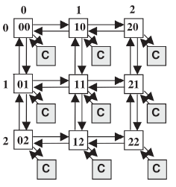
ASPIN: Rebeca abstract model
reactiveclass Router{
knownrebecs
{Router[4] neighbor, Core myCore}
statevars{int[4] buffer;}
Router (myId-row, myId-col) { …
}
msgsrv reqSend() {
neighbor[x]. giveAck() after(3); . . .
}
msgsrv getAck() {
// receive ack from the receiver
// get ready for receiving the next packet
…
}
msgsrv giveAck (…) {
//if the message is for my core use it
myCore.forMyCore()
//send ack to the sender
sender.getAck() after(3);
// if not route it to the receiver …
} }
reactiveclass Core{
knownrebecs {Router myRouter}
statevars{ …}
Core ( … ) {
….
}
msgsrv forMyCore() {
// get the Packet and use it
. . .
}
main(){
Router r00(r02,r10,r01,r20)(0,0);
Router r01(r00,r11,r02,r21)(0,1);
…
Core c00(r00)
Core c01(r01)
…
}
Actor type and its message servers
Asynchronous message sending
Constructor
A message server
Instances of different actors
Parameters
Known rebecs

Slide 9
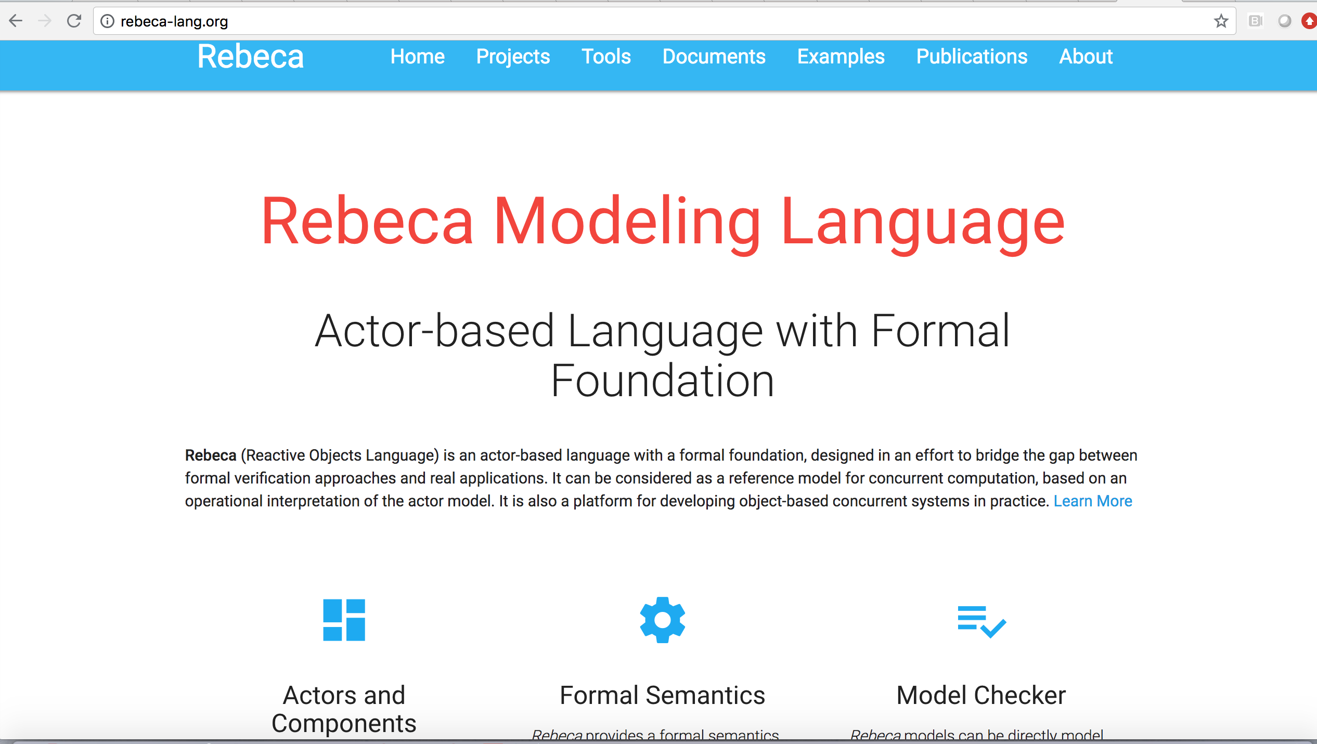
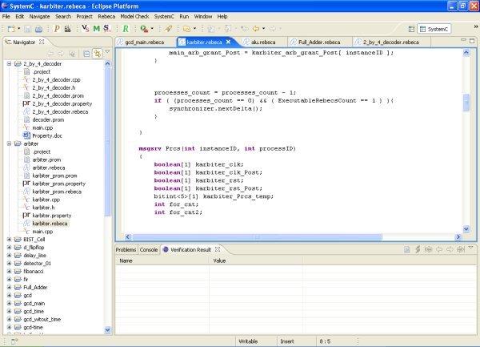

http://www.rebeca-lang.org/
Project editor
Model and Property editor
Model checking result view
Ten years of Analyzing Actors: Rebeca Experience (Sirjani, Jaghouri), Carolyn Talcott Festschrift, 70th birthday, LNCS 7000, 2011
On Time Actors (Sirjani, Khamespanah), Theory and Practice of Formal Methods, Frank de Boer Festschrift, 2016
Power is Overrated, Go for Friendliness! Expressiveness, Faithfulness and Usability in Modeling - The Actor Experience, Edward Lee Festschrift, 2017

Slide 10
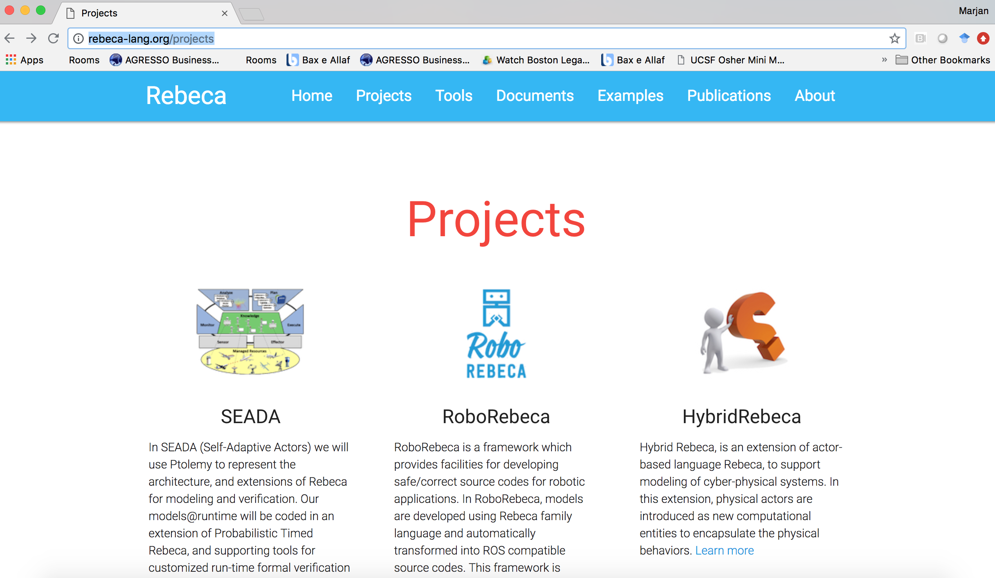
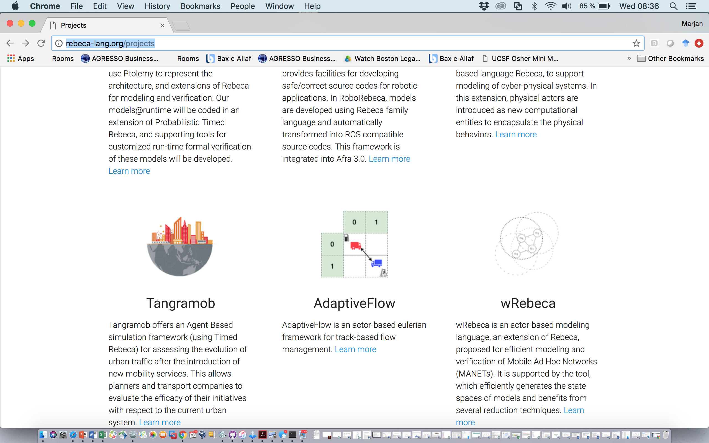

Slide 11
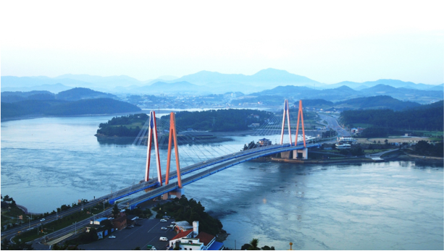
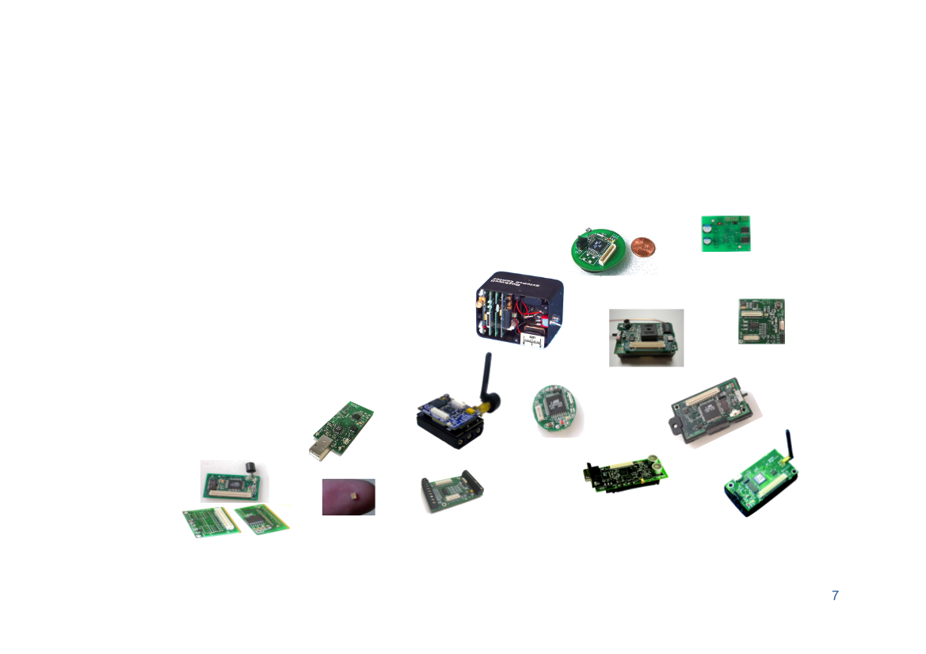
Smart Structures
Network Protocols
Schedulability Analysis of
Distributed Real-Time Sensor Network: Finding the best configuration
UIUC- Gul Agha
Deadlock and loop-freedom of Mobile Adhoc Networks
Acknowledged on the AODV page https://tools.ietf.org/html/draft-ietf-manet-aodvv2-16

Slide 12
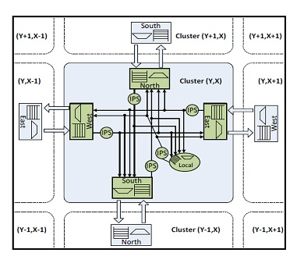
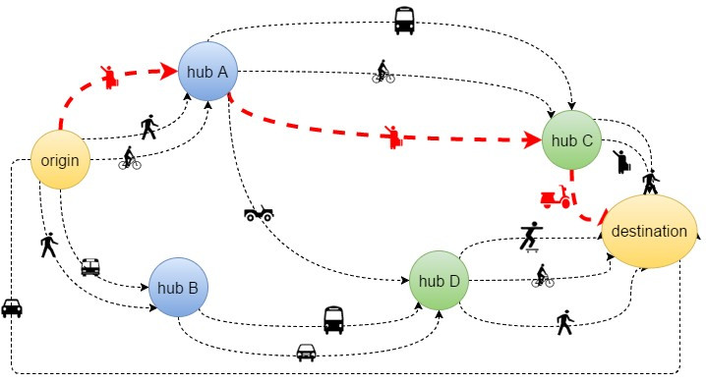
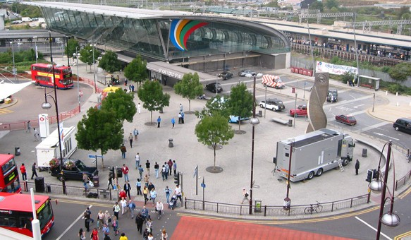
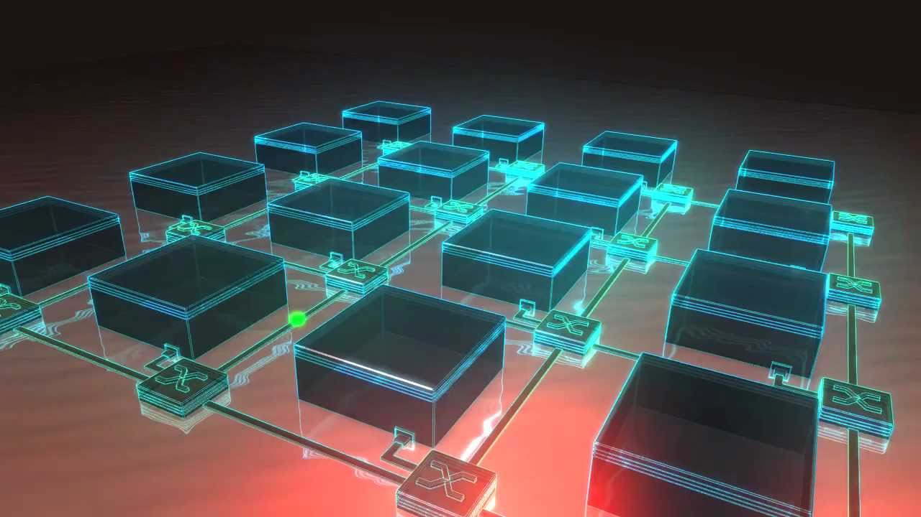
Network on Chip
Smart Transport Hubs
Optimization: Minimizing
Number of service disruptions
Number of mobility resources in smart hubs
Cost of mobility for commuters
Travel time for commuters Travel distance for commuters
Design Decisions:
routing algorithms
Buffer length
Memory Allocation

Slide 13
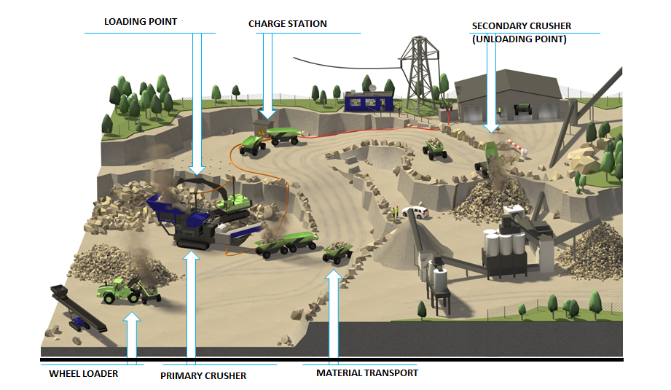
Adaptive Air Traffic Control
Volvo CE Quarry Site
Adaptive Air Traffic Control:
Safe rerouting of airplanes
Safe and optimized fleet control

Slide 14
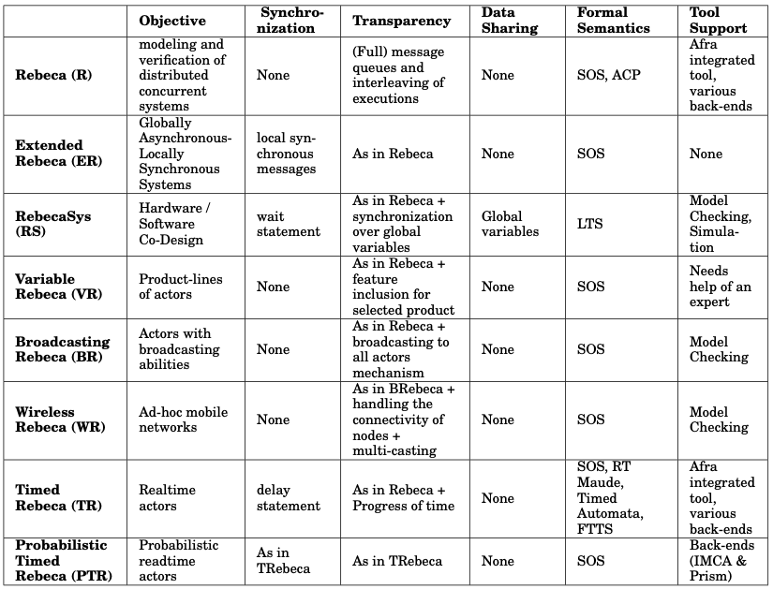
Rebeca Family Language
Await: RebecaSys

Slide 15
Why Rebeca?
Friendly for modeling
Efficient for Analysis
of Distributed Systems

Slide 16
Efficiency in Model Checking
Abstraction
Symmetry
Partial Order
Compositional Verification
Customized for actors
based on isolation of actors
(Related to Consistency and Isolation mentioned by Marc Shapiro
no consistency issues?)

Slide 17

Using Rebeca and Afra for Modeling and Model Checking
p → F q
φ
yes
Model
Checker
no
Error Trace
M

Slide 18
X1 = Red, X2 = Green

Slide 19

Traffic Lights
1
2
reactiveclass TrafficLight(5) {
knownrebecs {
TrafficLight tOther;
}
statevars {
byte Color;
}
TrafficLight(byte myId) {
Color = 0; /* red */
if (myId==1) {
self.RedtoGreen();
}
}
. . .
main {
TrafficLight traffic1(traffic2):(1);
TrafficLight traffic2(traffic1):(2);
}
msgsrv RedtoGreen() {
Color = 1; /* green */
self.GreentoYellow();
}
msgsrv GreentoYellow() {
Color = 2; /* yellow */
self.YellowtoRed();
}
msgsrv YellowtoRed() {
Color = 0; /* red */
tOther.RedtoGreen();
}

Slide 20
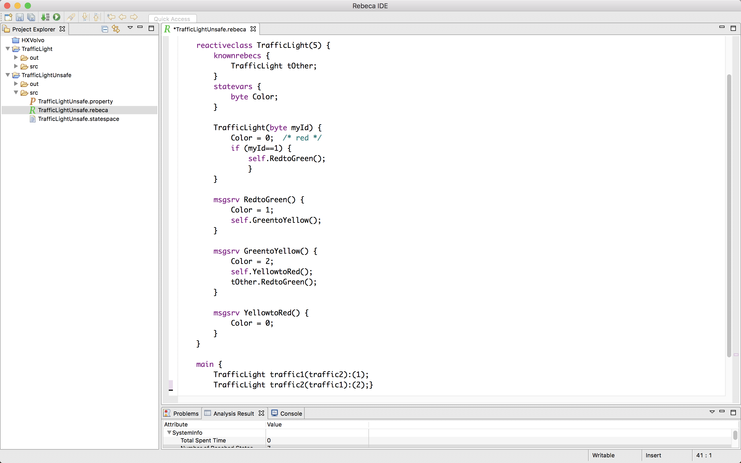
Rebeca Model: Traffic Lights
reactiveclass TrafficLight(5) {
knownrebecs {
TrafficLight tOther;
}
statevars {
byte Color;
}
TrafficLight(byte myId) {
Color = 0; /* red */
if (myId==1) {
self.RedtoGreen();
}
}
msgsrv RedtoGreen() {
Color = 1;
self.GreentoYellow();
}
msgsrv GreentoYellow() {
Color = 2;
self.YellowtoRed();
}
msgsrv YellowtoRed() {
Color = 0;
tOther.RedtoGreen();
}
}
main {
TrafficLight traffic1(traffic2):(1);
TrafficLight traffic2(traffic1):(2);
}
1
2

Slide 21

Rebeca Model: Traffic Lights
reactiveclass TrafficLight(5) {
knownrebecs {
TrafficLight tOther;
}
statevars {
byte Color;
}
TrafficLight(byte myId) {
Color = 0; /* red */
if (myId==1) {
self.RedtoGreen();
}
}
msgsrv RedtoGreen() {
Color = 1;
self.GreentoYellow();
}
msgsrv GreentoYellow() {
Color = 2;
self.YellowtoRed();
}
msgsrv YellowtoRed() {
Color = 0;
tOther.RedtoGreen();
}
}
main {
TrafficLight traffic1(traffic2):(1);
TrafficLight traffic2(traffic1):(2);
}
1
2
self.RedtoGreen( )
/* green */

Slide 22
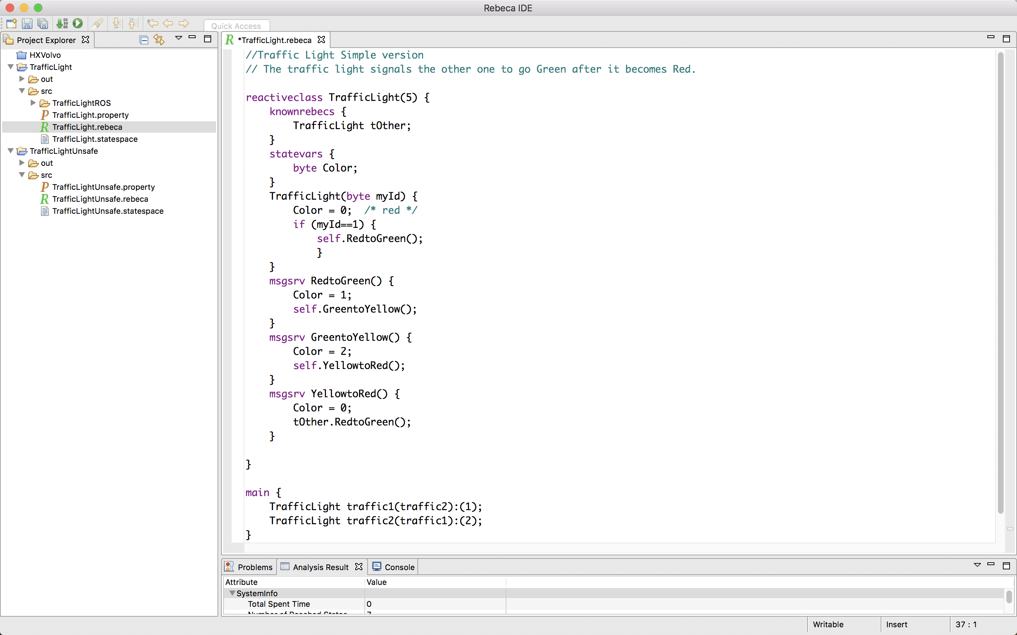
Rebeca Model: Traffic Lights
reactiveclass TrafficLight(5) {
knownrebecs {
TrafficLight tOther;
}
statevars {
byte Color;
}
TrafficLight(byte myId) {
Color = 0; /* red */
if (myId==1) {
self.RedtoGreen();
}
}
msgsrv RedtoGreen() {
Color = 1;
self.GreentoYellow();
}
msgsrv GreentoYellow() {
Color = 2;
self.YellowtoRed();
}
msgsrv YellowtoRed() {
Color = 0;
tOther.RedtoGreen();
}
}
main {
TrafficLight traffic1(traffic2):(1);
TrafficLight traffic2(traffic1):(2);
}
1
2
self.GreentoYellow( )
/* yellow */

Slide 23
Rebeca Model: Traffic Lights
reactiveclass TrafficLight(5) {
knownrebecs {
TrafficLight tOther;
}
statevars {
byte Color;
}
TrafficLight(byte myId) {
Color = 0; /* red */
if (myId==1) {
self.RedtoGreen();
}
}
msgsrv RedtoGreen() {
Color = 1;
self.GreentoYellow();
}
msgsrv GreentoYellow() {
Color = 2;
self.YellowtoRed();
}
msgsrv YellowtoRed() {
Color = 0;
tOther.RedtoGreen();
}
}
main {
TrafficLight traffic1(traffic2):(1);
TrafficLight traffic2(traffic1):(2);
}
1
2
self.YellowtoRed( )
/* red */

Slide 24
Rebeca Model: Traffic Lights
reactiveclass TrafficLight(5) {
knownrebecs {
TrafficLight tOther;
}
statevars {
byte Color;
}
TrafficLight(byte myId) {
Color = 0; /* red */
if (myId==1) {
self.RedtoGreen();
}
}
msgsrv RedtoGreen() {
Color = 1;
self.GreentoYellow();
}
msgsrv GreentoYellow() {
Color = 2;
self.YellowtoRed();
}
msgsrv YellowtoRed() {
Color = 0;
tOther.RedtoGreen();
}
}
main {
TrafficLight traffic1(traffic2):(1);
TrafficLight traffic2(traffic1):(2);
}
1
2
tOther.RedtoGreen( )
/* green */

Slide 25
Rebeca Model: Traffic Lights
✓
1
2
tOther.RedtoGreen( )
/* green */
$φ_{1}=G\left(¬\left(green_{1} ∧ green_{2}\right)\right)$ → NO CONCURRENT GREEN

Slide 26
Safe Rebeca Model: State-space
t1.RedtoGreen()
t1.GreentoYellow()
t1.YellowtoRed()
t2.RedtoGreen()
t2.GreentoYellow()
1
2
1
2
1
2
1
2
1
2
1
2
t2.YellowtoRed()

Slide 27
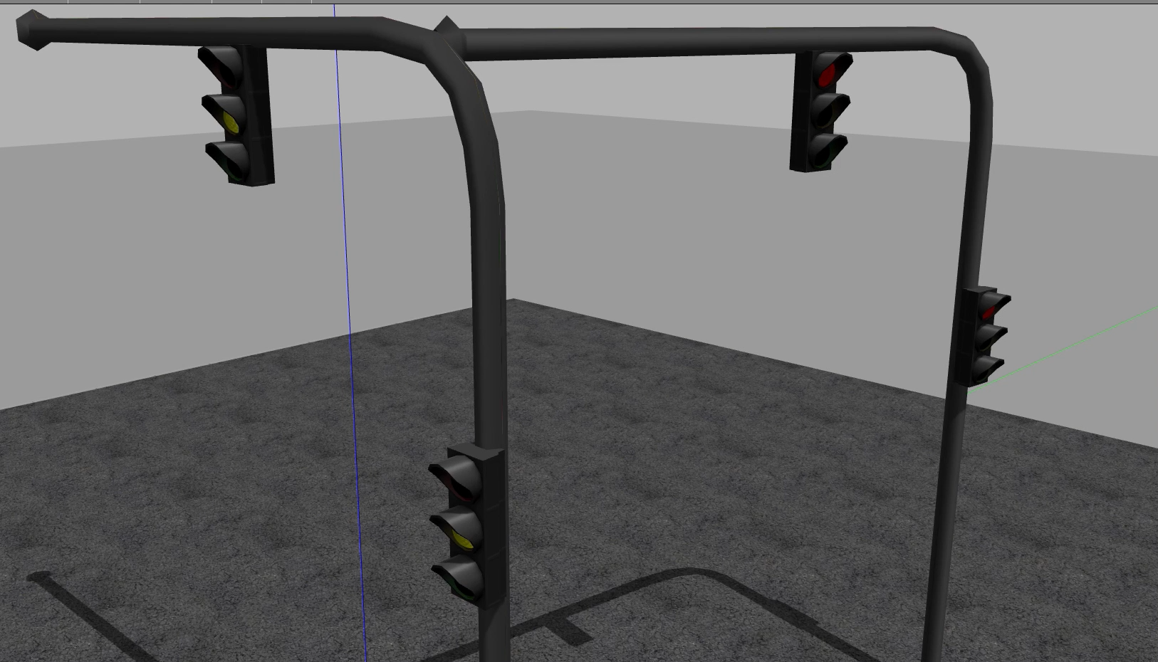
Automatic ROS code Generation
✓
Traffic Lights Model in Rebeca is mapped to a ROS code for simulation

Slide 28
Impatient Rebeca Model: Traffic Lights
reactiveclass TrafficLight(5) {
knownrebecs {
TrafficLight tOther;
}
statevars {
byte Color;
}
TrafficLight(byte myId) {
Color = 0; /* red */
if (myId==1) {
self.RedtoGreen();
}
}
msgsrv RedtoGreen() {
Color = 1;
self.GreentoYellow();
}
msgsrv GreentoYellow() {
Color = 2;
self.YellowtoRed();
tOther.RedtoGreen();
}
msgsrv YellowtoRed() {
Color = 0;
}
}
main {
TrafficLight traffic1(traffic2):(1);
TrafficLight traffic2(traffic1):(2);
}
1
2

Slide 29
Impatient Rebeca Model: Traffic Lights
1
2
self.RedtoGreen( )

Slide 30
Impatient Rebeca Model: Traffic Lights
1
2
self.GreentoYellow( )

Slide 31
What will happen here?

Slide 32
Impatient Rebeca Model: Traffic Lights
1
2
tOther.RedtoGreen( )

Slide 33
Impatient Rebeca Model: Traffic Lights
1
2
tOther.RedtoGreen( )

Slide 34
Impatient Rebeca Model: State-space
t2.GreentoYellow()
t2.RedtoYellow()
1
2
1
2
t1.RedtoGreen()
t1.GreentoYellow()
1
2
1
2
1
2
t2.YellowtoRed()
t1.YellowtoRed()
t1.YellowtoRed()
t1.RedtoGreen()
1
2
1
2
1
2
…
t1.YellowtoRed()
t2.YellowtoRed()
t2.RedtoGreen()
t2.GreentoYellow()

Slide 35
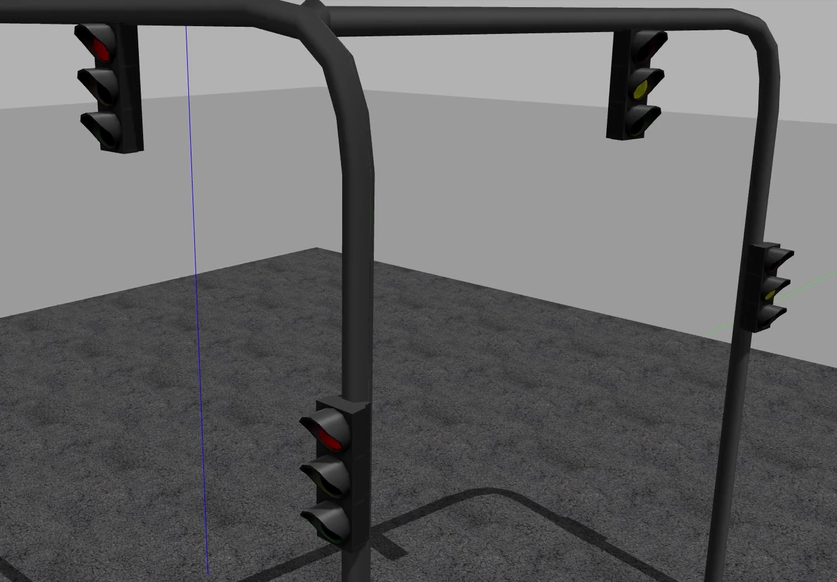
Impatient Rebeca Model: Traffic Lights
$φ_{1}=G\left(¬\left(green_{1} ∧ green_{2}\right)\right)$ → NO CONCURRENT GREEN ✓
$φ_{n}=G\left(¬\left(yellow_{1} ∧ green_{2}\right)\right)$ → NO YELLOW AND GREEN ✗

Slide 36
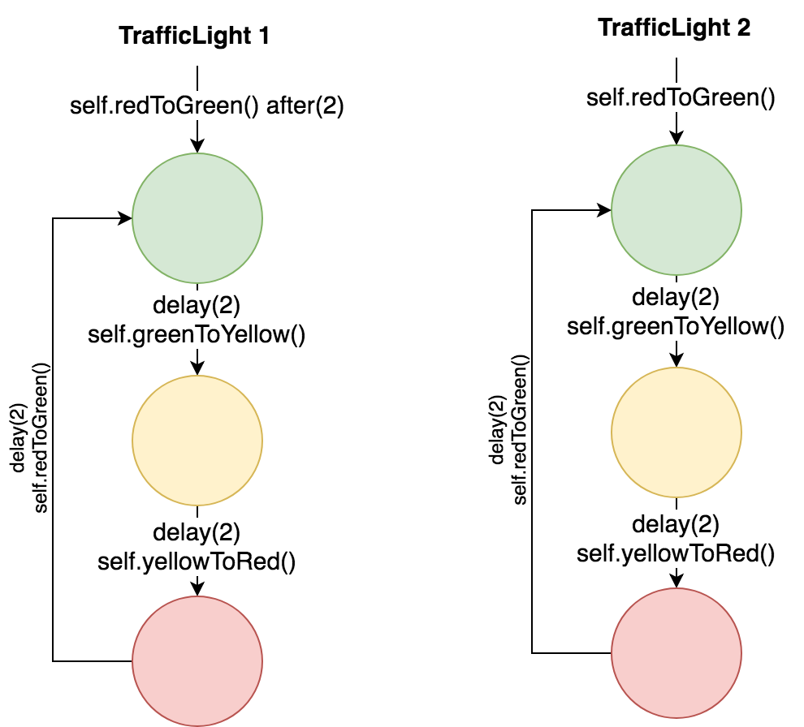
Timed Rebeca Model: Traffic Lights
$φ_{1}=G\left(¬\left(green_{1} ∧ green_{2}\right)\right)$ → NO CONCURRENT GREEN

Slide 37
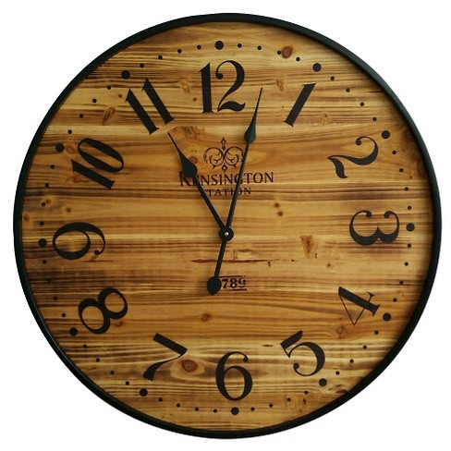
Timed Traffic Lights
1
2
reactiveclass TrafficLight(5) {
knownrebecs {
TrafficLight tOther;
}
statevars { byte Color;
}
TrafficLight(byte myId) {
Color = 0; /* red */
if (myId==1) {
self.RedtoGreen() after(2);
}
else self.RedtoGreen()
}
. . .
main {
TrafficLight traffic1(traffic2):(1);
TrafficLight traffic2(traffic1):(2);
}
msgsrv RedtoGreen() {
Color = 1; /* green */
delay(2);
self.GreentoYellow();
}
msgsrv GreentoYellow() {
Color = 2; /* yellow */
delay(2);
self.YellowtoRed();
}
msgsrv YellowtoRed() {
Color = 0; /* red */
delay(2);
self.RedtoGreen();
}

Slide 38
Timed Rebeca Model: Traffic Lights
1
2
reactiveclass TrafficLight(5) {
knownrebecs {
TrafficLight tOther;
}
statevars {
byte Color;
}
TrafficLight(byte myId) {
Color = 0; /* red */
if (myId==1) {
self.RedtoGreen() after(2);
}
else self.RedtoGreen()
}
TIME : 0
1
2
self.RedtoGreen( )
TIME : 0

Slide 39
Timed Rebeca Model: Traffic Lights
1
2
self.RedtoGreen( )
TIME : 0
msgsrv RedtoGreen() {
Color = 1; /* green */
delay(2);
self.GreentoYellow();
}

Slide 40
What will happen here?

Slide 41
Timed Rebeca Model: Traffic Lights
1
2
self.RedtoGreen( )
TIME : 2
msgsrv RedtoGreen() {
Color = 1; /* green */
delay(2);
self.GreentoYellow();
}

Slide 42
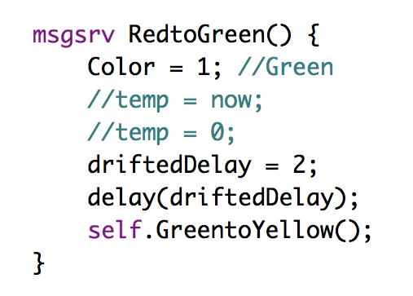
Timed Rebeca Model: Traffic Lights
1
2
self.RedtoGreen( )
TIME : 2
$φ_{1}=G\left(¬\left(green_{1} ∧ green_{2}\right)\right)$ → NO CONCURRENT GREEN ✘

Slide 43
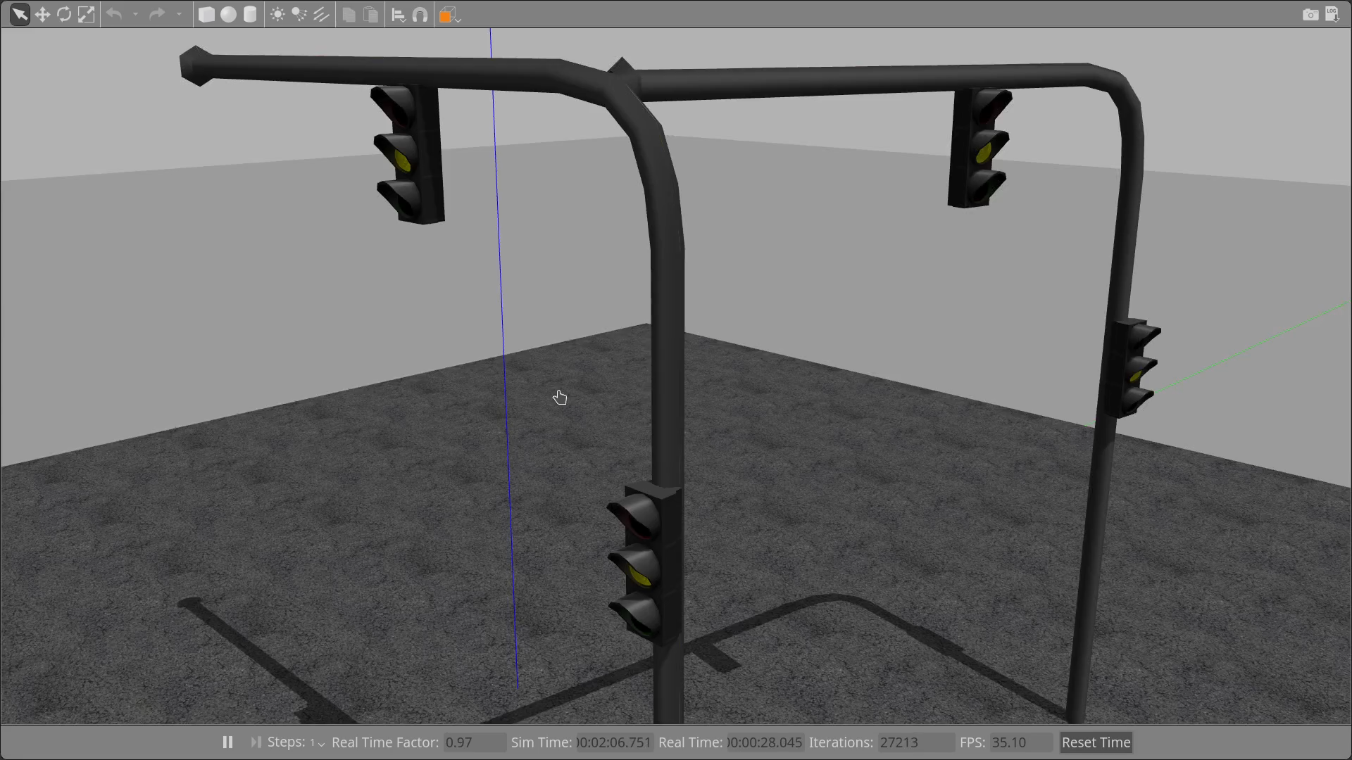
Timed Rebeca Model: Traffic Lights
$φ_{1}=G\left(¬\left(green_{1} ∧ green_{2}\right)\right)$ → NO GREEN AND GREEN ✗

Slide 44
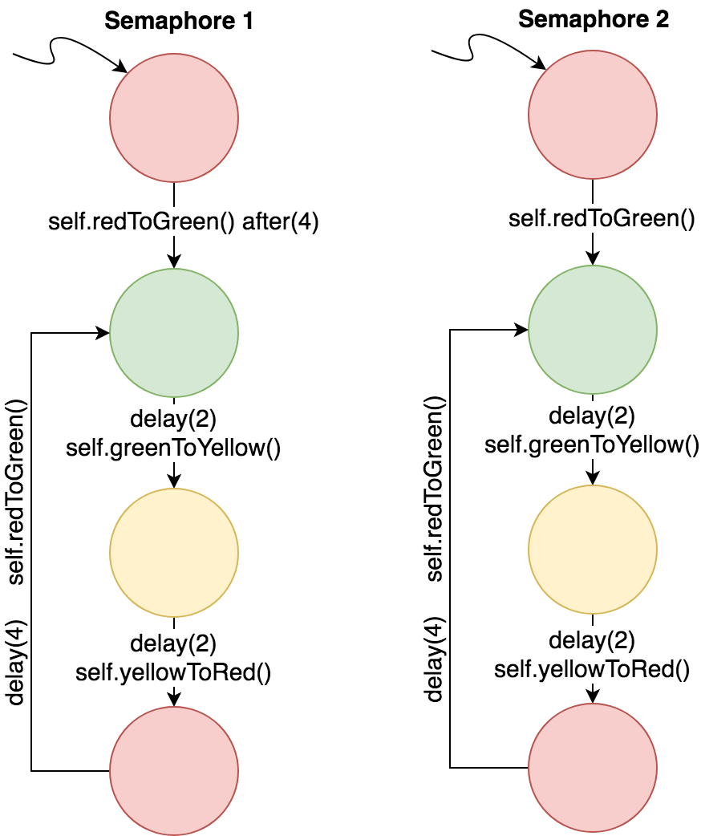
Timed Rebeca Model: Traffic Lights
Different shift in time

Slide 45
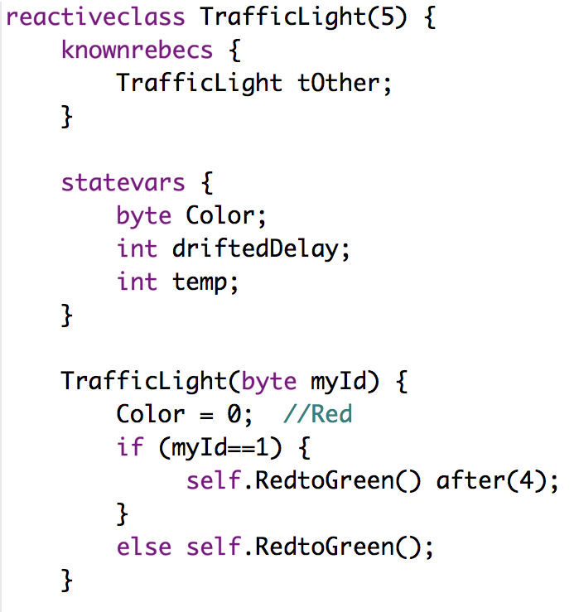
Timed Rebeca Model: Traffic Lights
Different shift in time
1
2
TIME : 0

Slide 46
Timed Rebeca Model: Traffic Lights
Different shift in time
1
2
self.RedtoGreen( )
TIME : 0
msgsrv RedtoGreen() {
Color = 1; /* green */
delay(2);
self.GreentoYellow();
}

Slide 47
Timed Rebeca Model: Traffic Lights
Different shift in time
1
2
self.GreentoYellow( )
TIME : 2
msgsrv GreentoYellow() {
Color = 2; /* yellow */
delay(2);
self.YellowtoRed();
}

Slide 48
Timed Rebeca Model: Traffic Lights
Different shift in time
1
2
1
2
self.RedtoGreen( )
or
self.YellowtoRed( )
TIME : 4
msgsrv RedtoGreen() {
Color = 1; /* green */
delay(2);
self.GreentoYellow();
}
msgsrv YellowtoRed() {
Color = 0; /* red */
delay(2);
self.RedtoGreen();
}

Slide 49
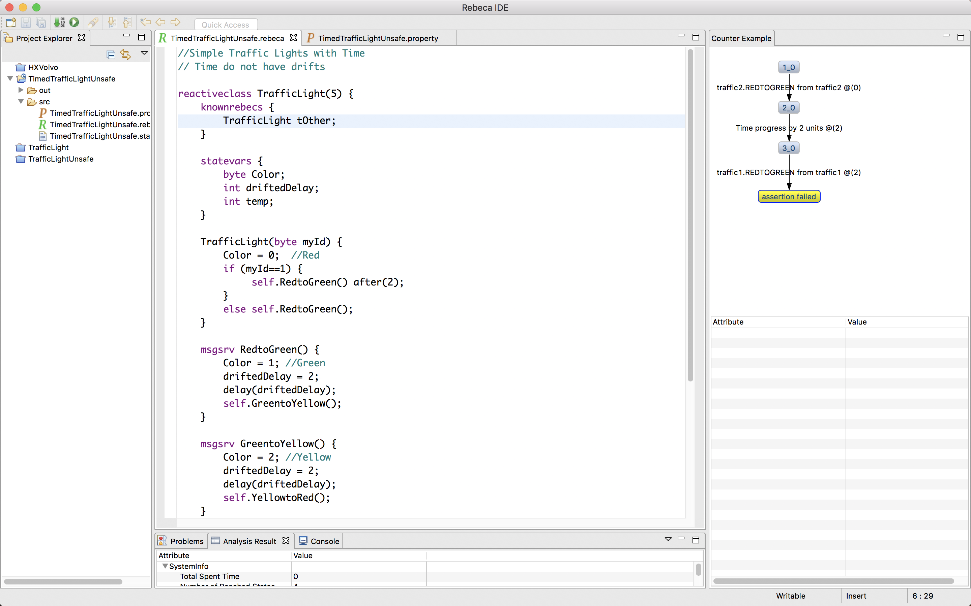
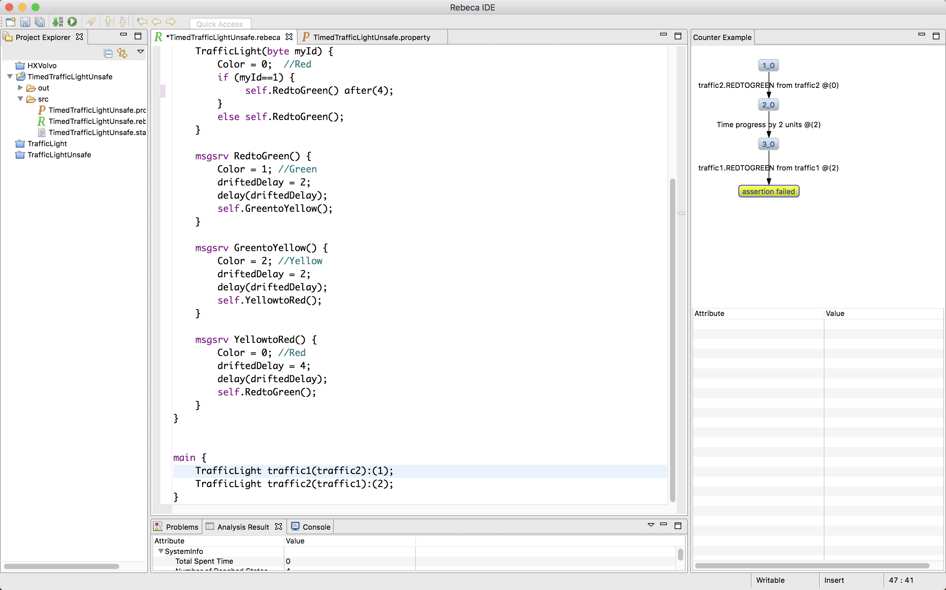
Timed Rebeca Model: Traffic Lights
Different shift in time
1
2
1
2
self.RedtoGreen( )
or
self.YellowtoRed( )
TIME : 4
$φ_{1}=G\left(¬\left(green_{1} ∧ green_{2}\right)\right)$ → NO CONCURRENT GREEN ✓

Slide 50
Timed Rebeca Model: Traffic Lights
Different shift in time
✓
1
2
1
2
self.RedtoGreen( )
or
self.YellowtoRed( )
TIME : 4
$φ_{1}=G\left(¬\left(green_{1} ∧ green_{2}\right)\right)$ → NO CONCURRENT GREEN ✓

Slide 51
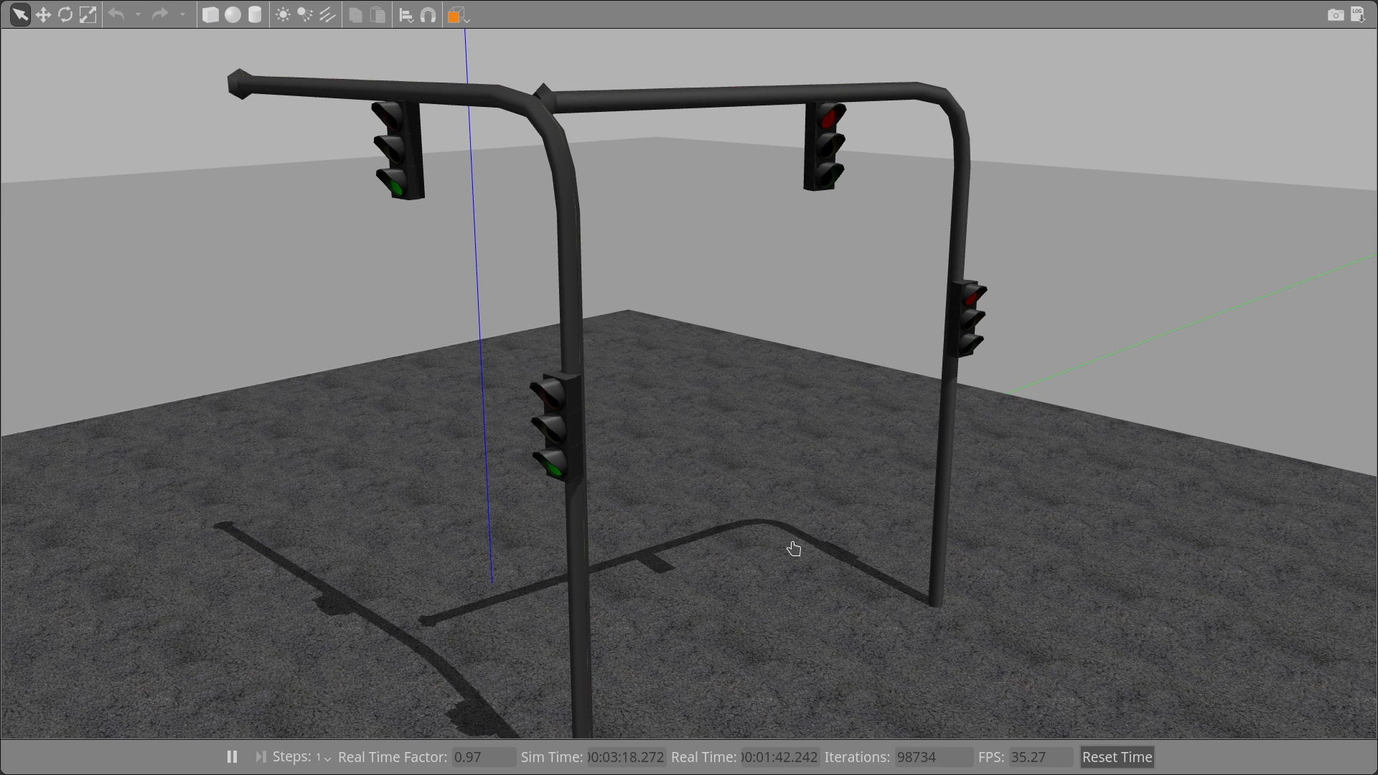
Timed Rebeca Model: Traffic Lights
Different shift in time
✓
$φ_{1}=G\left(¬\left(green_{1} ∧ green_{2}\right)\right)$ → NO CONCURRENT GREEN ✓

Slide 52
Efficient Model Checking of Timed Actors
Ehsan Khamespanah
Model
To do Analysis
State Space
Timed Automata
Timed Transition System
Floating Time Transition System

Slide 53


Different Levels of models
τ
Actor
<S₁,S₂,S₃>
τ
<S₁,S₂,S₃>
A
Actor
Actor
<S₁′,S₂′,S₃′>
<S₁′,S₂,S₃>
B
C
τ
τ
Distributed System Implementation
Actor Model
State Space for Verification

Slide 54
The Train Door System
When the train is running the external doors shall be kept closed and locked to avoid that passengers fall out of the train.

Slide 55
From Requirements to Model
Safety Requirements Elicitation for the Train Doors Control System
REQ ID | REQ DESCRIPTION | Elicited REQ ID
SSysSpecReq1 | GIVEN the train is ready to run WHEN the driver requests to lock the external doors THEN all the external doors in the train shall be closed and locked | SSysReq1
SSysSpecReq2 | GIVEN an external door is locked WHEN the passenger requests to open the external door THEN the external door shall be kept closed and locked | SSysReq2
SSysSpecReq3 | GIVEN an external door is unlocked WHEN the passenger requests to open the external door THEN the external door shall open | SSysReq3
SSysSpecReq4 | GIVEN all the external doors on the side of the train close to the platform are unlocked WHEN the driver requests to open all the external doors THEN all the external doors on the side of the train close to the platform shall be open | SSysReq3
SSysSpecReq5 | GIVEN the train arrives at a station AND the train speed is less than 0.5 km/h WHEN the driver requests to unlock all external doors that are on the train side close to the platform THEN all the external doors on that side of the train shall be unlocked | SSysReq4
Notes:
After eliciting the safety requirements with the SARE approach, the safety requirements are rephrased using the GIVEN-WHEN-THEN syntax in order to have a more structured form. When the requirements are written in this style it is easy to model them in Rebeca.

Slide 56
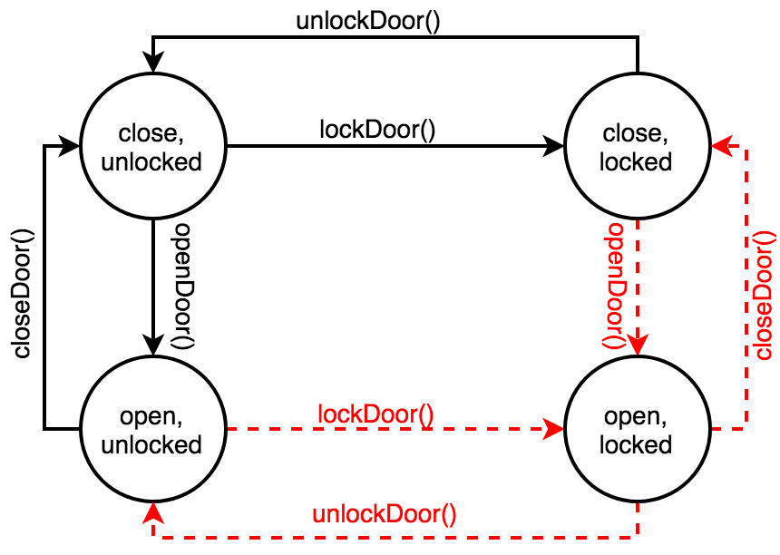
We want to verify that it is not possible to open a locked door or lock an open door.

Slide 57
State Diagrams
Train
Approached
Approached
& Unlocked & open
door.openDoor()
train.leaveStation() after (50)
approachStation() after (239)
status = true
leaveStation() after (50)
status = false
Approached Unlocked & closed
Leaving
Unlocked & open
Leaving
door.unlockDoor()
door.closeDoor()
Approached locked & closed
Leaving
Unlocked & closed
Door
train.approachStation() after (239)
Leaving
locked & closed
door.lockDoor()
closeDoor()
unlockDoor()
Unlocked & open
Unlocked & closed
locked & closed
Controller
openDoor()
lockDoor()

Slide 58
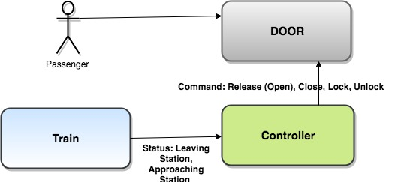
Architecture
Approached
approachStation()
leaveStation()
Leaving

Slide 59
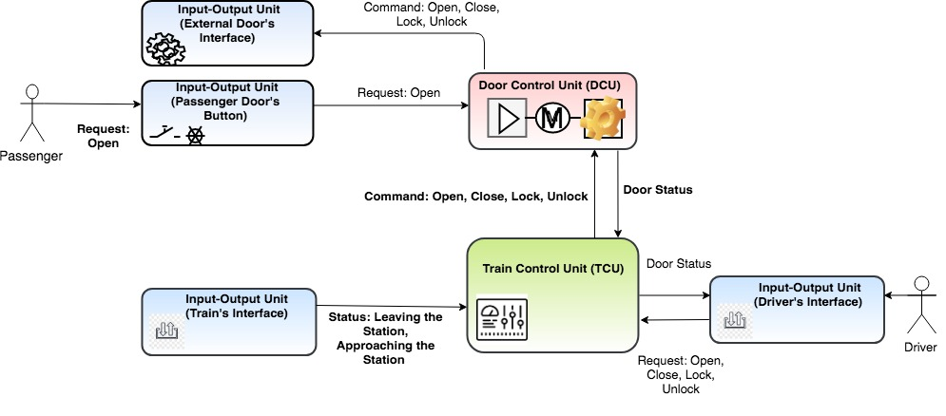
Architecture

Slide 60
Architecture
Modeled as Door
Modeled as Passenger
Modeled as Train
Modeled as Controller

Slide 61
reactiveclass Train(10){
knownrebecs{
Controller controller; }
statevars{
boolean status;}
Train(){
status = true;
self.leaveStation();
}
msgsrv leaveStation(){
status = true;
controller.setTrainStatus(status)
after(networkDelayTrain);
self.approachStation() after (runningTime);
}
msgsrv approachStation(){
status = false;
controller.setTrainStatus(status)
after(networkDelayTrain);
self.leaveStation() after(atStationTime);
}
}
reactiveclass Door(15){
knownrebecs{
Controller controller;}
statevars{
boolean isDoorClosed, isDoorLocked;}
Door(){
isDoorClosed = false; isDoorLocked = false;
}
msgsrv closeDoor(){
isDoorClosed = true;
controller.setDoorStatus(isDoorClosed,
isDoorLocked) after(networkDelayDoor);
}
msgsrv lockDoor(){
isDoorLocked = true;
controller.setDoorStatus(…);
}
msgsrv unlockDoor(){…}
msgsrv openDoor(){…}
}
Approached
approachStation()
leaveStation()
Leaving

Slide 62
reactiveclass controller(10){
knownrebecs{
Door door; }
statevars{
boolean isClosed, isLocked, trainStatus;}
Controller(){
trainStatus = true; isClosed, isLocked = false;
}
msgsrv setDoorStatus(boolean close, lock){
isClosed = close; isLocked = lock;
}
msgsrv setDoorStatus(boolean status){
trainStatus = status;
self.driveController();
}
}
msgsrv driveController(){
if(trainStatus){ // leave the station
if(!isClosed || !isLocked) {
if(!isClosed) {
door.closeDoor() after(nd);
delay(reactionDelay);
}
if(!isLocked) {
door.lockDoor() after(nd);
}
}
}// end of if(trainStatus)
else if(!trainStatus){ // arrive the station
if(isClosed || isLocked) {
if (isLocked) {
door.unlockDoor() after(nd);
delay(reactionDelay);
}
if (isClosed) {
door.openDoor() after(nd);
} } …
}

Slide 63
reactiveclass passenger(10){
knownrebecs{
Door door; }
Passenger(){
self.passengerOpenDoor() after(passP);
}
msgsrv passengerOpenDoor(){
door.openDoor();
self.passengerOpenDoor() after(passP);
}
}
main {
Controller controller(door):();
Door door(controller):();
Train train(controller):();
Passenger passenger(door):();
}

Slide 64
Challenges?
Architecture
Implementation

Slide 65
Properties
REQ ID | REQ DESCRIPTION | Elicited REQ ID
SSysSpecReq1 | GIVEN the train is ready to run WHEN the driver requests to lock the external doors THEN all the external doors in the train shall be closed and locked | SSysReq1
Assertion 1:
!doorIsOpen && doorIsLocked
We want to verify that it is not possible to open a locked door

Slide 66
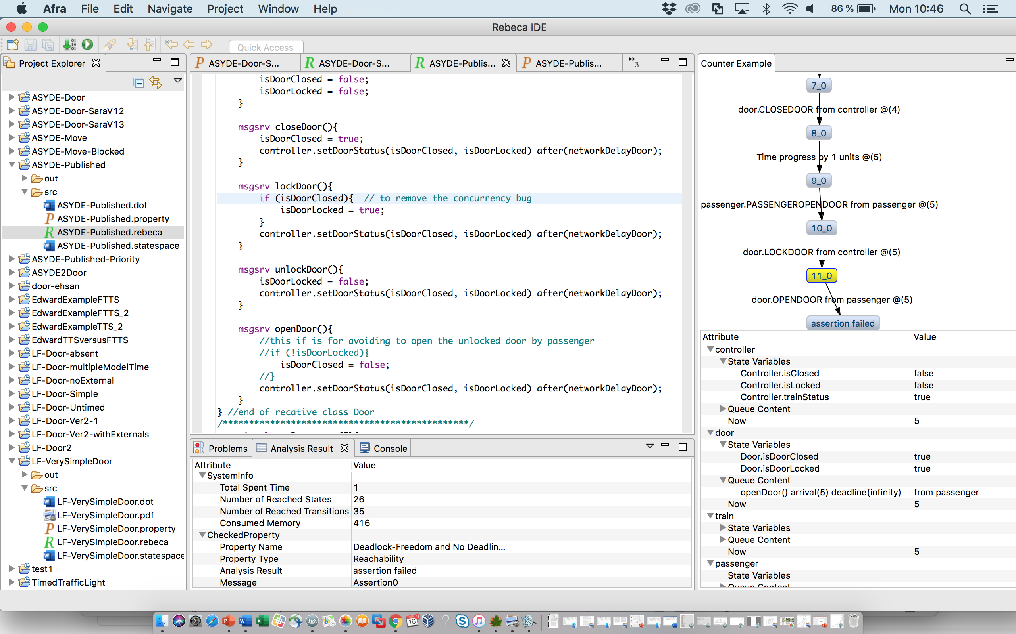
Counter Example

Slide 67
Debug based on the counter-example
reactiveclass Door(15){
knownrebecs{
Controller controller;}
statevars{
boolean isDoorClosed, isDoorLocked;}
Door(){
isDoorClosed = false;
isDoorLocked = false;
}
msgsrv closeDoor(){
isDoorClosed = true;
controller.setDoorStatus(isDoorClosed,
isDoorLocked) after(networkDelayDoor);
}
msgsrv lockDoor(){
if (isDoorClosed) {
isDoorLocked = true;
}
controller.setDoorStatus(isDoorClosed,
isDoorLocked) after(networkDelayDoor);
}
msgsrv unlockDoor(){
isDoorLocked = false;
controller.setDoorStatus(isDoorClosed,
isDoorLocked) after(networkDelayDoor);
}
msgsrv openDoor(){
if (!isDoorlocked) {
isDoorClosed = false;
}
controller.setDoorStatus(isDoorClosed,
isDoorLocked) after(networkDelayDoor);
}
}
locked & open
lockDoor()
openDoor()

Slide 68
Refine to add Running state to Train
reactiveclass Train(10){
knownrebecs{
Controller controller; }
statevars{
boolean status;
boolean running;
}
Train(){
status = true; running = false;
self.leaveStation();
}
msgsrv leaveStation(){
status = true;
controller.setTrainStatus(status, running)
after(networkDelayTrain);
self.approachStation() after (runningTime);
}
msgsrv approachStation(){
status = false;
controller.setTrainStatus(status , running)
after(networkDelayTrain);
self.leaveStation() after(atStationTime);
}
msgsrv move(){
running = true;
controller.setTrainStatus(status , running)
after(networkDelayTrain);
self.approachStation() after (runningTime);
}
}
leaveStation() after (t1)
status = false
running = false
Approached
Leaving
approachStation() after (t2)
status = true
running = false
Running
move() after (t1)
status = false
running = true

Slide 69
reactiveclass controller(10){
knownrebecs{
Door door; }
statevars{
boolean isClosed, isLocked, trainStatus;}
Controller(){
trainStatus = true; isClosed, isLocked = false;
}
msgsrv setDoorStatus(boolean close, lock){
isClosed = close; isLocked = lock;
}
msgsrv setDoorStatus(boolean status){
trainStatus = status;
Refine to add Running state to Train: Changes to Controller
msgsrv driveController(){
if(trainStatus){ // leave the station
if(!isClosed || !isLocked) {
if(!isClosed) {
door.closeDoor() after(nd);
delay(reactionDelay);
}
if(!isLocked) {
door.lockDoor() after(nd);
}
}
if(isClosed && isLocked && !commandToMove) {
commandToMove =true;
train.move() after(networkDelayTrain);
}
}// end of if(trainStatus)
else if(!trainStatus){ // arrive the station
{ if …
door.unlockDoor() after(nd);
delay(reactionDelay);
}
if (isClosed) {
door.openDoor() after(nd);
} } … }

Slide 70
Properties
REQ ID | REQ DESCRIPTION | Elicited REQ ID
SSysSpecReq1 | GIVEN the train is ready to run WHEN the driver requests to lock the external doors THEN all the external doors in the train shall be closed and locked | SSysReq1
Assertion:
!train.running && door.IsOpen
Assertion:
!train.running && door.IsUnlock

Slide 71
Progress Property - Timing
REQ ID | REQ DESCRIPTION | Elicited REQ ID
SSysSpecReq1 | GIVEN the train is ready to run WHEN the driver requests to lock the external doors THEN all the external doors in the train shall be closed and locked | SSysReq1
env byte networkDelayDoor = 1;
env byte networkDelayTrain = 3;
env byte reactionDelay = 5;
env byte passengerPeriod = 5;
env int runningTime = 15;
env byte atStationTime = 10;
reactiveclass passenger(10){
knownrebecs{
Door door; }
Passenger(){
self.passengerOpenDoor() after(passP);
}
msgsrv passengerOpenDoor(){
door.openDoor();
self.passengerOpenDoor() after(passP);
}
}
Property:
F train.running
Assertion:
!(trainRunning)
Leave at time 0,
Cannot lock the door and move until time 21.
Passenger can be seen as an attacker too!

Slide 72
Model Checking Lingua Franca
With Edward Lee
lock
Door
Controller
move
Train
move
Lohstroh, M., Schoeberl, M., Goens, A., Wasicek, A., Gill, C., Sirjani, M., and Lee, E. A. Actors revisited for time-critical systems.
In Proceedings of the 56th Annual Design Automation Conference 2019, DAC 2019, Las Vegas, NV, USA, June 02-06, 2019 (2019), ACM, pp. 152:1–152:4.

Slide 73
Model Checking Lingua Franca

Slide 74
Lingua Franca code
target C;
reactor Controller {
output lock:bool;
output move:bool;
physical action external_move: bool;
initialize {=
... Set up sensing.
=}
reaction(external_move)-> {=
set(lock, true);
set(move, true);
=}
}
reactor Door {
input lock:bool;
state locked:bool(false);
reaction(lock) {=
self->locked = lock;
=}
}
reactor Train {
state moving:bool(false);
reaction(move) {=
if (move) {
self->moving = true;
} else {
self->moving = false;
}
=}
}
reactor Main {
controller = new Controller();
door = new Door();
train = new Train();
controller.lock -> door.lock;
controller.move -> train.move;
}

Slide 75
To
Model checking LF using Rebeca
State Space using Afra

Slide 76
More Readable State Sapce
trainNotMoving
doorUnLock
controllerNotMovePresent
trainMoving
doorLock
controllerMovePresent
S1
S3
move
move
lock
trainNotMoving
doorLock
controllerMovePresent
trainMoving
doorLock
controllerMovePresent
S2
S5
lock
move
Note:
Event and time transitions
External Events
Shift in Time
Different semantics and implementation platforms
trainNotMoving
doorLock
controllerMovePresent
time += 1
S4
trainMoving
doorLock
controllerMovePresent
S6
!move
trainNotMoving
doorLock
controllerMoveNotPresent
S8
!move
!lock
trainMoving
doorLock
controllerMoveNotPresent
trainNotMoving
doorUnLock
controllerMoveNotPresent
S7
S10
!lock
trainMoving
doorUnLock
controllerMoveNotPresent
!move
S9
time += 1
1>>2
S1

Slide 77
Lingua Franca code with Passenger
target C;
reactor Controller {
output lock:bool;
output move:bool;
physical action external_move: bool;
initialize {=
... Set up sensing =}
reaction(external_move)-> {=
set(lock, true); set(move, true);
=}
}
reactor Door {
input lock:bool;
input open:bool;
state locked:bool(false);
reaction(lock) {=
self->locked = lock;
=}
reaction(open) {=
if (!self->locked) { Actuate}
=}
}
reactor Train {
…
}
reactor Button {
output open: bool;
physical action button: bool;
initialize {=
... Set up sensing =}
reaction(button)-> open {=
set(open, true);
=}
}
reactor Main {
…
}
open
Door
Controller
open
lock
move
Train
move

Slide 78
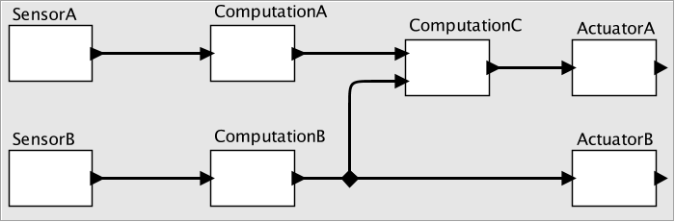
Edward Lee: Questions That can be Addressed by Lingua-Franca
What combinations of periodic, sporadic, behaviors are feasible?
How do execution times affect feasibility? How can we know execution times?
How do we get repeatable and testable behavior even when communication is across networks?
How do we specify, ensure, and enforce deadlines?

Slide 79
References
For publications, see
http://rebeca-lang.org/publications
For projects, see
http://rebeca-lang.org/projects

Slide 80
QUESTIONS?

